Slide 1




Spatial interaction under imperfect competition
Robin Morphet
r.morphet@ucl.ac.uk
UCL CENTRE FOR ADVANCED SPATIAL ANALYSIS
THE BARTLETT

Slide 2
UCL CENTRE FOR ADVANCED SPATIAL ANALYSIS
THE BARTLETT
‘regional scientists and geographers have developed several models, ranging from the entropy (Wilson, 1967) to the gravity
and logit models(Anas, 1983) which has proven to be very effective in predicting different types of flows. By ignoring
for a long time this body of research, spatial economists have missed a fundamental ingredient of the space-economy.’
(Fujita and Thisse, 2013, p256)
4th September 2015
Bari
Spatial interaction under imperfect competition
Robin Morphet
r.morphet@ucl.ac.uk
‘regional scientists and geographers have developed several models, ranging from the entropy (Wilson, 1967) to the gravity and logit models(Anas, 1983) which has proven to be very effective in predicting different types of flows. By ignoring for a long time this body of research, spatial economists have missed a fundamental ingredient of the space-economy.’
(Fujita and Thisse, 2013)
Notes:
Looking in this talk to
Develop the links between land-use theory, spatial interaction and economics
Economics has in the past, been rather shy of explicitly including space although this changed in the past with the understanding of spatial pricing (Greenhut) where
its generality in relation to other forms of market impediments, was recognised.
Some of the difficulty in explicitly representing space related to the adherence to ideas perfect competition.
Fujita, M. And Thisse, J.-F., “Economics of Agglomeration: Cities, Industrial Location, and Globalization”, Cambridge University Press; Cambridge, 2013 ,(p256)

Slide 3
UCL CENTRE FOR ADVANCED SPATIAL ANALYSIS
THE BARTLETT
The Context
‘transport costs are almost universally ignored in trade models in the sanguine hope that if included they would not materially affect the results’ (Deardorff 1984)
‘it seems unlikely that we will see technological convergence between the economic geographers and the geographical economists any time soon’ (Overman 2004)
‘In spatial interaction models there is no ..... statement about prices of any of the commodities, not even of land’ (Barra, 1989)
‘Could the entropy approach deal with price (especially land-rent) distributions as well as with physical allocations? Partial answers to these questions were provided by Senior and Wilson (1974), Anas (1973), and others, but urban economics was on a track of its own and showed signs of maturing independently. The uneasy fit between entropy models and economic models still remains, but I hope that some of this tension will be relaxed...’ (Anas, 1984)
‘Bid rent theory … serves as a framework for pencil-and-paper theoretical models, but the econometric estimation and large scale policy application of these models has proved to be difficult, unmanageable, and frustrating. In part because of this, the applied fields of transportation planning and urban modeling – which stand to benefit from urban economics – have remained largely separate from it.’ (Anas 1982)
Notes:
Economic analysis has tended to ignore space as Deardorff identifies but his further critique of trade models (from which the ‘New Economic Geography’ is derived), are equally telling. The models are limited to two countries with one traded good etc similarly NRG tends towards monocentric to 3 centres with iceberg costs and a racetrack geometry.
Economic models have been theoretical rather than operational
The development of Spatial interaction models since the 1970s has been largely operational so an opportunity has been missed by both economic geographers and geographical economists
I stand in the middle as an engineer planner wanting models backed by an operational theory
Deardorff, A. V. 1984. Testing trade theories and predicting trade flows. Handbook of international economics, 1. Amsterdam: North-Holland, pp467-517

Slide 4
UCL CENTRE FOR ADVANCED SPATIAL ANALYSIS
THE BARTLETT
The Problem
In a perfectly competitive economy we can expect the total value of rents (payment for the use of land at a given location) in the local economy to equal the total cost of transport. Any variation in the cost of transport will have an immediate and opposite effect on land rents. Thus it is reasonable to ignore property related issues in a transport appraisal on the assumption of perfect competition. In an imperfectly competitive world this relationship will cease to hold and there will be important changes in welfare which are not measured by the transport benefits. This is compounded by the further linkage between the labour market and property market through home ownership and potential migration. Thus a more careful
representation of the land and property markets, especially the link between property prices, home ownership, commuting and migration, is a further major requirement. This could be a further development of the labour market study recommended above.
(Transport and the Economy, SACTRA Report, 1998)
Notes:
The difficulties faced in evaluation were highlighted in the SACTRA report of 1998
Perfect competition requires that rent increases will equal trip cost savings over time. This if true would make trip cost savings a reliable measure of total benefit
Of course there is the question of consumer surplus and the benefits accruing to ‘new users’ but we will come to that.

Slide 5
UCL CENTRE FOR ADVANCED SPATIAL ANALYSIS
THE BARTLETT
The Approach
Define imperfect competition and rent in spatial interaction
Examine the problem in terms of what is permitted in the spatial interaction (trip
distribution) model
Analyse a demonstration example in London
See https://www.bartlett.ucl.ac.uk/casa/publications/working-paper-199
and https://www.bartlett.ucl.ac.uk/casa/publications/working-paper-193
Notes:
In looking at these questions I am looking at the model as it is, what it permits and what it does not.
This means that the use of standard economic methods may not always be appropriate.
The details are contained in the two working papers listed at the bottom of the slide although these may be subject to revision.

Slide 6
UCL CENTRE FOR ADVANCED SPATIAL ANALYSIS
THE BARTLETT
Imperfect Competition (1)
Perfect competition is achieved when transport costs are zero (Starrett 1974)
Imperfect competition arises when transport costs are non-zero although they
may be positive or negative (i.e. overcharged or subsidised)
Imperfect competition may be monopoly, oligopoly, monopolistic competition
Notes:
The analysis is based on two basic ideas
Starrett’s Impossibility Theorem
The generalisation of von Thunen land rents to spatial interaction
-----------------------------------------------------------------------------------------------------------------
Dealing first with Starrett he showed that the point of perfect competition in a spatial economy, can only arise when transport costs are zero -- i.e. Never!
Given that we can define this point the analysis can be applied to any form of imperfect competition including those that are rendered imperfect by subsidy
The use of the term ‘imperfect’ suggests a pejorative – however this would be a mistake as it is what we see around us and it seems to form the basis of the agglomeration economies on which successful cities depend.

Slide 7
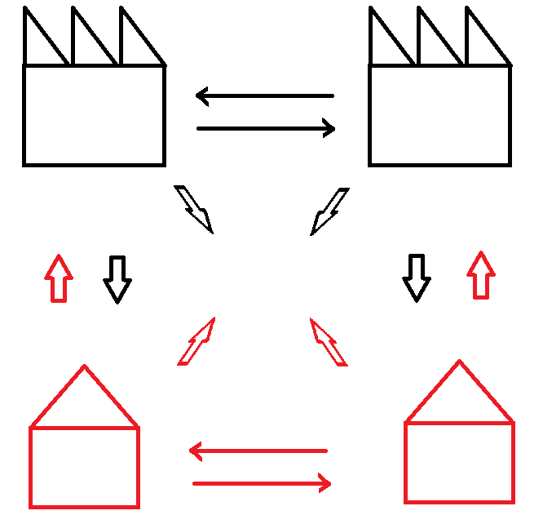
UCL CENTRE FOR ADVANCED SPATIAL ANALYSIS
THE BARTLETT
Imperfect Competition (2)
Firms compete and cooperate
Firms and households trade
Households compete and cooperate
Notes:
Starret’s Impossibility Theorem
The price system has two roles
to deliver a spatial equilibrium
to deliver a market Pareto equilibrium
where market players trade with each other (the non traded intermediates of agglomeration) they can always increase profits by co-locating thus reducing transport costs and potentially taking market share thus disturbing the spatial equilibrium.
Hence the price system has two conflicting objectives unless trip costs are zero
In the diagram above we are treating households and firms as market players. Firms trade and compete with each other. Household compete to supply labour. Both compete for land. We have co-opetition at all levels
1 No relocation cost: All agents are free to move
2 Homogeneous space: all immobile resources are uniformly distributed over locations.
As a result, consumer preferences and firm technologies are location-invariant.
(s(r), z(r)) instead of .r (s(r), z(r)) for example.
3 Closed economy No exports nor imports.
4 Perfect & complete market everywhere
Under the assumptions above, there is no competitive
equilibrium with positive transport cost, so the only
possible competitive equilibrium is one in which no
good or person is transported.
By competitive, we mean all the agents are price
takers.
This as you may guess is a rather cursory introduction - the need for zero trip costs was identified in the 1950’s by Koopmans and Beckmann’s analysis of the quadratic assignment problem.
The Impossibility Theorem is best presented in Fujita and Thisse
Assignment Problems and the Location of Economic Activities
Tjalling C. Koopmans and Martin Beckmann
Econometrica, Vol. 25, No. 1 (Jan., 1957), pp. 53-76

Slide 8
UCL CENTRE FOR ADVANCED SPATIAL ANALYSIS
THE BARTLETT
Rent and Spatial Interaction
The rent in the spatial interaction model is the von Thunen land rent
per trip
It is already incorporated in the model ‘s balancing factors and is a
location rent
It can be incorporated into the generalised cost giving a generalised
trip and land cost
Notes:
In an earlier talk I dealt with the derivation of the von Thunen land rent within the spatial interaction model.
This is in WP 193 so I will not repeat it here except to say that the land-rent per trip is a function of the balancing factors and trip ends.
It is a location rent produced by decisions on transport investment and on activity location. These are essentially public decisions and the increment in value they produce should legitimately return to the public. This is a topic to which I see we will return during the conference.
We incorporate rent into the generalised cost rather in the same way that we incorporate time and travel cost.
This incorporation was first urged by Neuburger and Wicox (1976) but was not recognised as rent. He did however distinguish between values arising in relation to accessibility and niceness. In our case, location rent and environmental quality.
Neuburger, H. and Wilcox, J., "The Economic Appraisal of Land-Use Plans", Journal of Transport Economics and Policy, Vol. 10, No. 3 (Sep., 1976), pp. 227-236 (section 10)
Senior and Williams recognised these functions as rent but in a dual analysis

Slide 9
UCL CENTRE FOR ADVANCED SPATIAL ANALYSIS
THE BARTLETT
Rent, Interaction and Consumer Surplus
The standard (almost) derivation
giving
Now log both sides, multiply by divide by and sum over i,j giving
Or entropy/β - consumer surplus = expected rent + expected trip cost
Benefit equation:
Δentropy/β+<tripcost>)=Δ(Consumer surplus + <rent>)
Notes:
The almost arises from the introduction of the last constraint which gives rise to Z, the partition function
The derivation of the maximum entropy model gives an expression for Pij which we can log, sum and divide by beta to give us the basic relationship for evaluation which we use in this analysis
Note the relation of the logsum of random utility theory to Z, the partition function of statistical mechanics.
The entropy/beta has dimensions of cost = beta is the information/cost modulus
The consumer surplus is the Gibbs free energy of classical thermodynamics
So we return the standard surplus measure of RUM with no distributional assumptions as shown by Anas.
The benefit equation is the basic equation of this analysis
Anas A., “Discrete choice theory, information theory and the multinomial logit and gravity models”, Transportation Research Part B: Methodological, Volume 17, Issue 1, pp 13–23, 1983

Slide 10
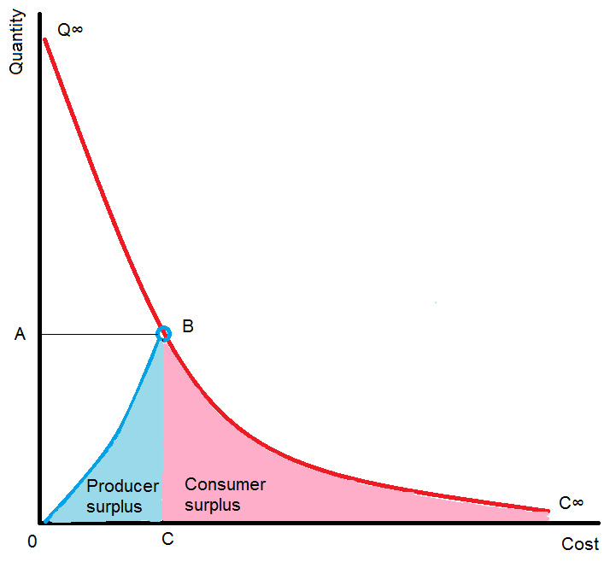
UCL CENTRE FOR ADVANCED SPATIAL ANALYSIS
THE BARTLETT
Perfect Competition in the Spatial Interaction Model
Z is the determinant of the demand curve
Notes:
This assumes a standard downward sloping demand curve.
The cost is the total cost of trip cost and land rent
Z determines the demand curve since it includes both beta and Cij
Any change in Z will give rise to a different demand curve
We tend to ignore producer surplus partly because it is difficult partly because sometimes producers are also consumers
More importantly we will find that unlike other elements it is not conserved.

Slide 11
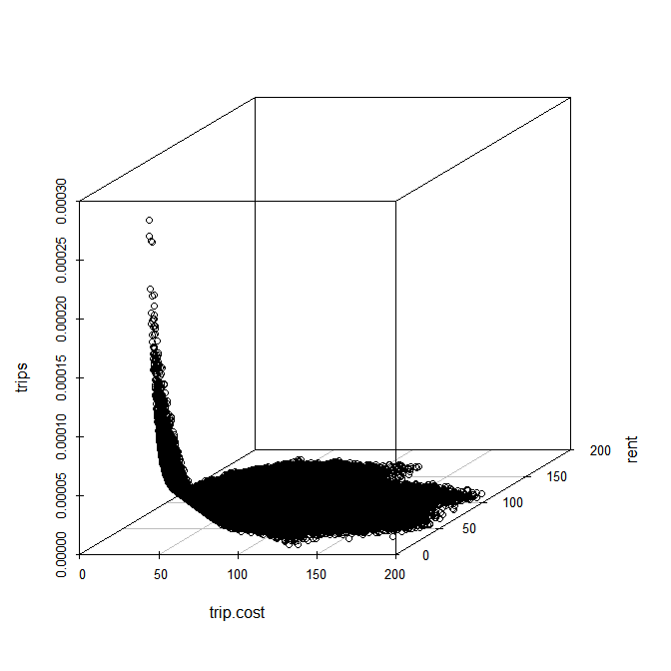
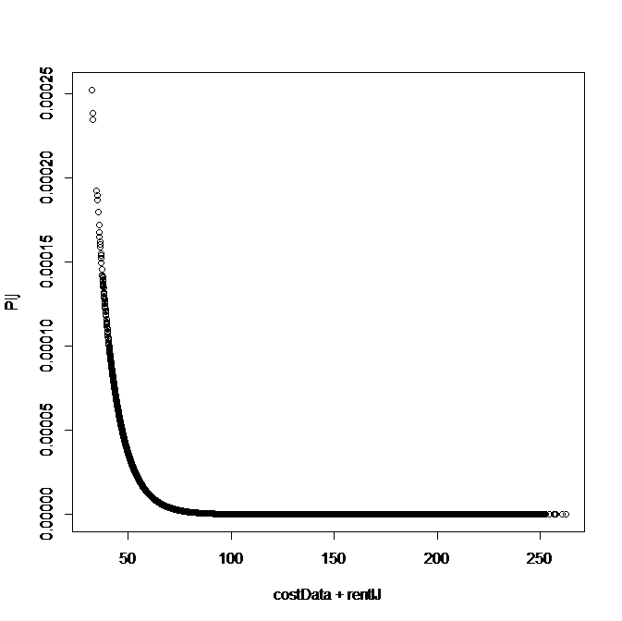
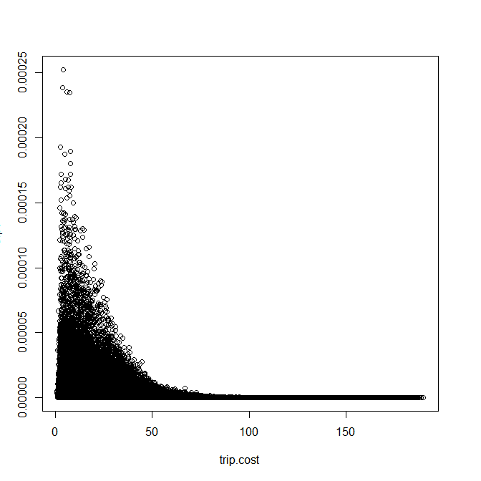
UCL CENTRE FOR ADVANCED SPATIAL ANALYSIS
THE BARTLETT
Demand Curve dependence on Rent
Notes:
It is worth looking at the effect of including rent in the cost function. We use data from the calibrated model of the example we introduce later which uses the Arcadia data set from the 2001 Census
On the left we show a three dimensional plot of trips against rent an trip cost giving a smooth surface with irregular edges
On the right we plot trips against trip cost showing a rather messy plot.
In the centre we plot trips against trip cost + rent. This gives a smooth ‘curve’ which could be interpreted as a demand curve
The need to include rent in the analysis seems inescapable

Slide 12
UCL CENTRE FOR ADVANCED SPATIAL ANALYSIS
THE BARTLETT
Imperfect Competition and Consumer Deadweight Loss
Benefit equation:
Δ(Deadweight loss +cost)=Δ(Consumer surplus + rent)
Notes:
The consumer deadweight loss is given by the beige area
There is also a producer deadweight loss which defined by the blue line to the left of the consumer deadweight loss.
However we do not have reliable information on the supply curve - a continuing problem in this area of work not helped by the ambiguity between supplier and consumer (a driver may be both)
We define the Starret point PiPj on the curve
It has an implied rent by comparison with the standard model so although trip costs are zero at point B rents are still positive
Integrate from point B to the current equilibrium point to get (1/beta) times Mutual Information – this is related to Neuburger’s utility function
If we then set the model up as an information minimising model we end up with
The standard form of model according to webTag
(webTag Appendix D5.1 p69 TAG Unit M2 Variable Demand Modelling)
The spatial interaction model therefore minimises consumer deadweight loss
This minimisation is also reflected in labour matching models (Galichon)
Now let us look at the effect of reducing transport costs
Neuburger, H. , “User Benefit in the Evaluation of Transport and Land Use Plans”, Journal of Transport Economics and Policy, Vol. 5, No. 1, 1971, pp. 52-75 (eqn. 44)

Slide 13
UCL CENTRE FOR ADVANCED SPATIAL ANALYSIS
THE BARTLETT
Imperfect Competition and Consumer Deadweight Loss
Notes:
The conventional single demand curve for a reduction in cost. Sliding up it produces a consumer surplus Y + Z
The deadweight loss reduces by X + Y but the trip cost increases by X and decreases by Z
This is a helpful simplification but reality is more complex in particular the different values of Pij correspond to different values of Z, i.e. to different demand curves
There is no reason (in the model) why PiPj should represent the lowest cost
The Pijs may straddle PiPj

Slide 14
UCL CENTRE FOR ADVANCED SPATIAL ANALYSIS
THE BARTLETT
Deadweight Loss Configurations
 | {t_{ij}¹ , t_{ij}² } > t_{s} | t_{s} between {t_{ij}¹ , t_{ij}² } | {t_{ij}¹ , t_{ij}² } < t_{s}
t_{ij}¹ > t_{ij}²
t_{ij}² > t_{ij}¹
Notes:
Anything which can happen does happen
Again using the analysis of our example we have 6 cases all of which occur
The standard analysis is shown in the top left corner and the shadings show the varieties of deadweight loss configuration
Straddling is the least common cofiguration
Decreasing costs may produce a fall in trips and vice versa
Some costs may be less than that of perfect competition (effective subsidy)
Since the Cij are fixed any change in Pij due to diversion can only be restored to the demand curve by a change in rent
However there are more substantial difficulties inherent in the standard analysis

Slide 15
UCL CENTRE FOR ADVANCED SPATIAL ANALYSIS
THE BARTLETT
The Mandate of the Interaction Model
The interaction model is an equilibrium model
The demand curve is a series of disconnected points at equilibrium
The costs include land rent
Not all cost points are admissible
There are three distinct demand curves
We cannot move up and down the demand curve
Notes:
Far from there being one demand curve we may observe 3 (again using example data)
Base Year
Design Year
Starret
Although base and design year are very similar they are not the same
These relate to 3 values of Z viz Z1, Z2 and Zstarrett
There is no demand curve as such – we have only equilibrium points on a curve
The points between are not defined and are inadmissible.
If we consider a demand curve based just on trip cost only the Cij are admissible nothing else is on offer.
This means in measuring benefit change we must rely on differences in state variables (i.e. those extensive variables defined at equilibrium)
Fortunately this simplifies calculations as we have only 2 rather than 6 cases to compare

Slide 16
UCL CENTRE FOR ADVANCED SPATIAL ANALYSIS
THE BARTLETT
Fixing the Balancing Factors
Notes:
Just as the balancing factors are unique relative to the probabilities, only up to a multiplicative constant so the rents are unique to the probabilities only up to an additive constant.
However, in the Starret equilibrium we have a unique point of reference for which Z=1.
We can line all curves up with Starret by rolling Z into the exponent of the numerator
It is incorporated in the cost bracket and split equally between the origin and destination rents to preserve biproportionality.
It cannot be applied to the Cij as these are fixed.
Even when on the perfect competition curve not all the benefit is converted to rent and the deadweight loss remains
It should be noted that this is a manipulation. The functions remain the same. We have a conservation and a symmetry (translation).
Fixing the balancing factors in this way should permit comparisons over time and between studies.

Slide 17
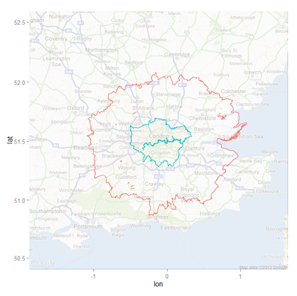
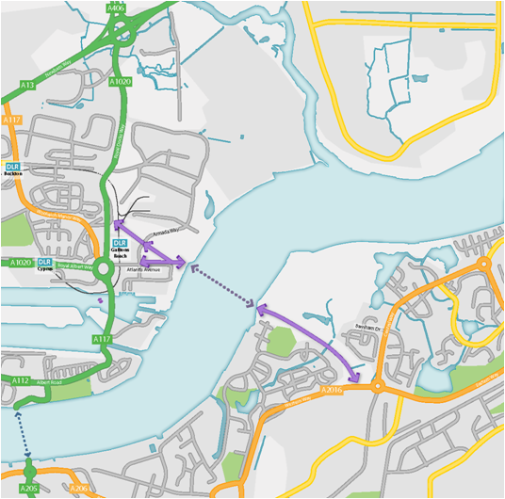
UCL CENTRE FOR ADVANCED SPATIAL ANALYSIS
THE BARTLETT
The Study Area: Gallions Reach
No. of zones: 1,767
Population: 13,428,853
Observed trips: 6,245,233
Notes:
The Arcadia study area
1767 zones
13.5 million population
6.25 million work trips
We use an all modes work trip model derived from the 2001 Census
---------------------------------------------------------------------------------------------------------------
Although there are proposals for Gallions reach – this model does not offer any conclusions as to feasibility or desirability. It is chosen because I was familiar with the area.
The design year changes in trip cost are applied directly to the trip cost matrix based on a reduced crossing time which is circumscribed in its impact on surrounding trip cost reductions.
It gives values sufficient to explore and stress test some of the relationships in the model (as we have seen) and to check the algebra

Slide 18
UCL CENTRE FOR ADVANCED SPATIAL ANALYSIS
THE BARTLETT
Comparison of benefit changes
Uncorrected rents
Corrected rents
Notes:
This diagram gives the benefit measures for the case of corrected and uncorrected rents.
The trip cost are net (ie savings – increased costs)
Note rent greater than trip cost so some additional benefit ( we can prove –although it is not yet published- that rent gains will never be less than trip cost benefits)
Deadweight loss + trip cost = Consumer Surplus + rent
The consumer surplus is Marshallian at this stage.
Both slight less than Rule of Half (which uses only savings in trip costs) – reflecting its linear overestimate
Travel time cost is in minutes
All benefits shown as positive
DWL + trip cost is same as Jara-Diaz
DWL + trip cost is equal to CS + rent = total corrected rent
Comparing the bottom bars we may see that all trip cost change is absorbed by rent but the rent change is greater. Even when this happens we do not achieve perfect competition as the deadweight loss still exists
The total corrected rent gives a long term view of where the benefits may end up
The CS may be short lived
Jara-Diaz, S.R. and Farah, M., “Valuation of user’s benefits in transport systems”, Transport Reviews, vol 8, no.3, pp197-218, 1988 (eq. 50)

Slide 19
UCL CENTRE FOR ADVANCED SPATIAL ANALYSIS
THE BARTLETT
Benefits under Imperfect Competition
Benefit equation:
Δ(Deadweight loss +cost)=Δ(Consumer surplus + rent)
Benefit relation
Δ rent ≥ Δtrip cost
Notes:
The rent change will always be greater than the trip cost change with equality only under perfect competition.
We cannot separate rent and trip cost in the diagram.
However, we can use the benefit equation to show that the ratio of change in Deadweight Loss to change in
Consumer Surplus is always greater than 1 (relying on the convexity of Mutual Information)
This is shown for the Arcadia area.

Slide 20
UCL CENTRE FOR ADVANCED SPATIAL ANALYSIS
THE BARTLETT
Rent Distribution
Notes:
Polycentricity in destinations
Monocentricity in origins

Slide 21
UCL CENTRE FOR ADVANCED SPATIAL ANALYSIS
THE BARTLETT
Rent Change
Notes:
The binary divide is unusual but is not as we shall see a property of the model per se.
The changes in rent value outside the immediate area of change, are small but add up.

Slide 22
UCL CENTRE FOR ADVANCED SPATIAL ANALYSIS
THE BARTLETT
Components of Rent Change
Notes:
Rent per se is monocentric-radial
The binary divide shown by the intensive measure arises from the land use distribution
The policy levers are densification and land use change (or disinvestment)
We may need to densify western residential and increase residential land supply in the East
(This would possibly densify employment in the East and retain it in the West/centre)

Slide 23
UCL CENTRE FOR ADVANCED SPATIAL ANALYSIS
THE BARTLETT
Conclusions
the spatial interaction model including rent, estimates deadweight loss and
models imperfect competition
perfect competition is not feasible in a spatial economy
the benefits of transport investment can be measured by the change in
deadweight loss plus trip cost or the change in consumer surplus plus trip
cost or the maximum change in rent
the change in rent will never be less than the change in trip costs
the Rule of a Half approximates to these measures for small changes
the realisation of benefits is likely to require planned land use change
land rent is intrinsic to the spatial interaction model

Slide 24
UCL CENTRE FOR ADVANCED SPATIAL ANALYSIS
THE BARTLETT
Further Areas of Work
the question of second best
migration and the relaxation of the constraints
the analysis of agglomeration costs and benefits
within the model
the analysis of income distribution and spatial equity
the dynamics of land use change ... Z(t)
Notes:
In an economy with some un-correctable market failure in one sector, actions to correct market failures in another related sector with the intent of increasing economic efficiency may actually decrease overall economic efficiency. An assumption of perfect competition surrounding the system of interest is plainly wrong. We may need larger scale whole economy models. This may be of importance in addressing local/national evaluations in the context of devolution.
We have considered a model in which Origins and destinations are constant. It is possible to develop the model to include measures of migration within the classical thermodynamic paradigm
Agglomeration benefits include scale and network effects whilst costs include congestion - we have mentioned only labour market matching but we might also consider rational inattention theory in which Mutual Information is significant.
This will allow greater analysis of distributional effects – the relaxation of the O D constraints may allow partial measures of income to be included – we should also revisit von Thunen’s analysis of the fair wage.
The model is encapsulated in Z so any dynamic model will include Z(t) – minimum entropy production seems like a good route to follow
Similarly – we have a symmetry and a conservation so an Action must be there which we can measure(Noether’s theorem)

Slide 25
UCL CENTRE FOR ADVANCED SPATIAL ANALYSIS
THE BARTLETT
Spatial interaction under imperfect competition
Thank you for listening
More details on
https://www.bartlett.ucl.ac.uk/casa/publications/working-paper-199
and
https://www.bartlett.ucl.ac.uk/casa/publications/working-paper-193
Or contact on r.morphet@ucl.ac.uk

Slide 26
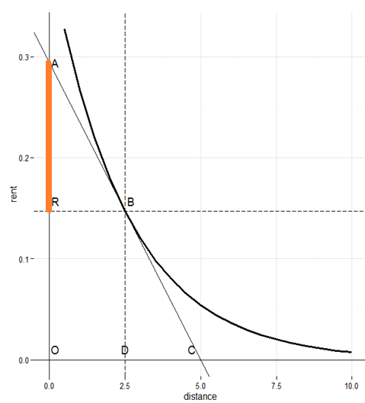
UCL CENTRE FOR ADVANCED SPATIAL ANALYSIS
THE BARTLETT
Notes:
The standard von Thunen construction
OR is rent
OD is distance from the centre
The slope at B gives the cost of transport per mile at that point
AR, assuming linearity, gives the total cost of a trip from B

Slide 27
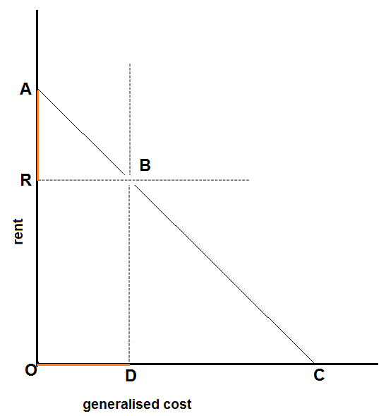
UCL CENTRE FOR ADVANCED SPATIAL ANALYSIS
THE BARTLETT
Notes:
The use of generalised cost rather than distance means that
OD = AR
Similarly we see that
OC = OA
The maximum rent (at zero distance) = OA
The maximum distance (at zero rent)=OC
The slope of the curve is -1

Slide 28
UCL CENTRE FOR ADVANCED SPATIAL ANALYSIS
THE BARTLETT
The Entropy Maximising Derivation of von Thunen
 | The City
O₁ | d_{1d}
O₂ | d_{2d}
... | ...
O_{i} | d_{id}
... | ...
O_{n} | d_{nd}
 | The City
O₁ | c_{1d}
O₂ | c_{2d}
... | ...
O_{i} | c_{id}
... | ...
O_{n} | c_{nd}
 | The City
p₁ | p_{1d}
p₂ | p_{2d}
... | ...
p_{i} | p_{id}
... | ...
p_{n} | p_{nd}
 | The City
p₁
p₂
... | ...
p_{i}
... | ...
p_{n}
 | The City
O₁ | d_{1d}
O₂ | d_{2d}
... | ...
O_{i} | d_{id}
... | ...
O_{n} | d_{nd}
 | The City
O₁ | c_{1d}
O₂ | c_{2d}
... | ...
O_{i} | c_{id}
... | ...
O_{n} | c_{nd}
 | The City
p₁ | p_{1d}
p₂ | p_{2d}
... | ...
p_{i} | p_{id}
... | ...
p_{n} | p_{nd}
 | The City
p₁
p₂
... | ...
p_{i}
... | ...
p_{n}
von Thunen
model
MaxEnt
probability
estimates
The Legendre
transform
von Thunen
model
von Thunen +
generalised cost
Observed trip
matrix
MaxEnt
probability
estimates
The Legendre
transform

Slide 29
UCL CENTRE FOR ADVANCED SPATIAL ANALYSIS
THE BARTLETT
Destination/Origin Relative Rent Change

Slide 30
UCL CENTRE FOR ADVANCED SPATIAL ANALYSIS
THE BARTLETT
Uncorrected Rent Change
Notes:
Similar to Corrected rent change as shown

Slide 31
UCL CENTRE FOR ADVANCED SPATIAL ANALYSIS
THE BARTLETT

Slide 32
UCL CENTRE FOR ADVANCED SPATIAL ANALYSIS
THE BARTLETT
Change in Rent per Trip

Slide 33
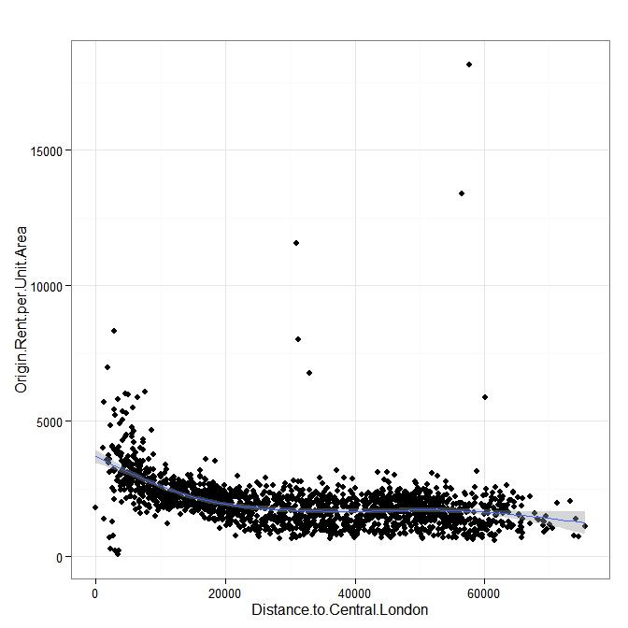
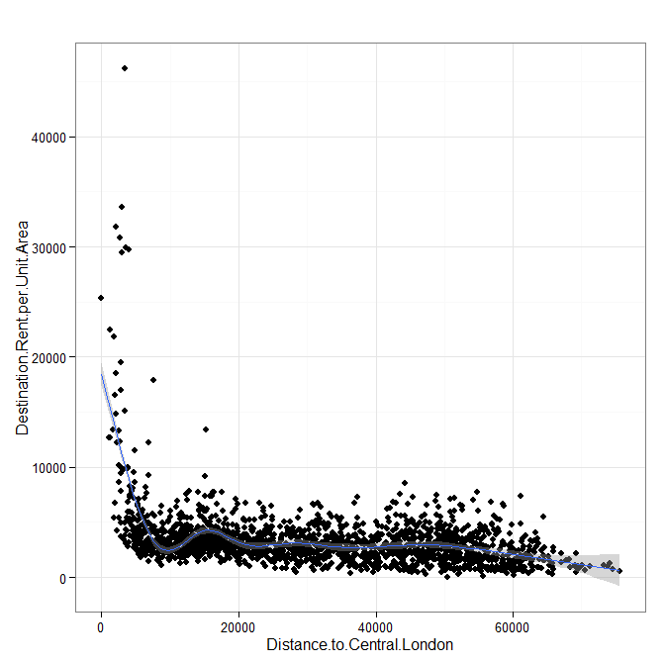
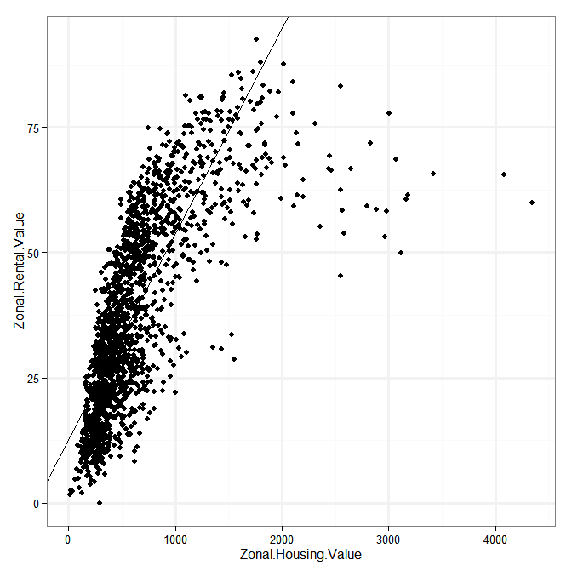
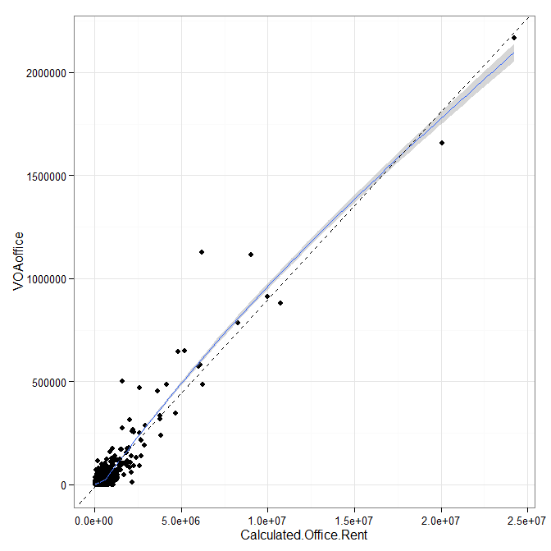
UCL CENTRE FOR ADVANCED SPATIAL ANALYSIS
THE BARTLETT
Calculated Rents against observations

Slide 34
UCL CENTRE FOR ADVANCED SPATIAL ANALYSIS
THE BARTLETT
Offices 2001: Floorspace Rateable Value relation

Slide 35
UCL CENTRE FOR ADVANCED SPATIAL ANALYSIS
THE BARTLETT

Slide 36
UCL CENTRE FOR ADVANCED SPATIAL ANALYSIS
THE BARTLETT
Before and After Demand Curves
Before After

